Slide 1
CDN, Bootstrap and Intro to functional javascript

Slide 2
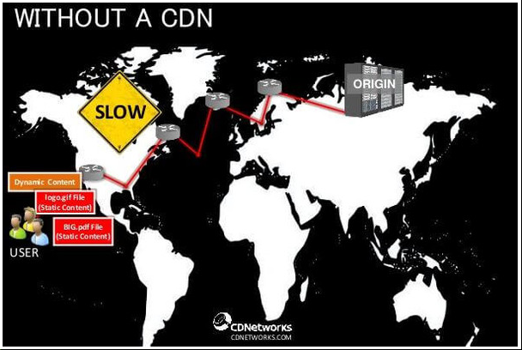
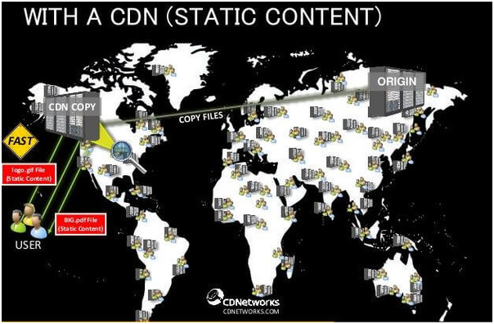
CDN( Content Delivery Network)
Spread across boundaries to delivery content to users
Helps in countering denial of service attack (DDOS) via Load Balancing
Load balancing is based on requested URL and proximity of server to user.

Slide 3
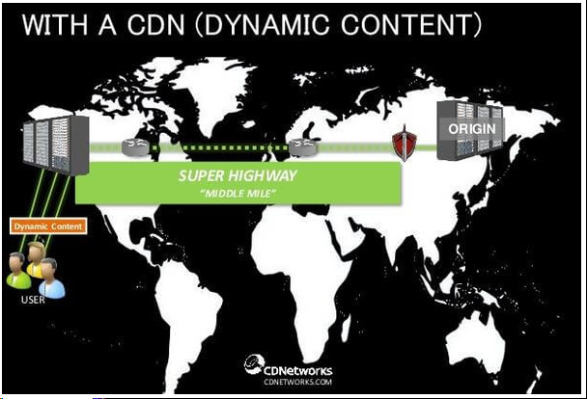
CDN for dynamic content

Slide 4
Services by maxcdn (CDN for bootstrap)
Instant Purge and Provisioning
Make your new origin deployments seen immediately.
Instant SSL
One-click activation for better security.
Realtime Reporting
Our real-time reporting and analytics engine gives meaning to your data so you can make informed decisions.
Total Automation
Our complete API and GitHub integration allows you to automate every aspect of your CDN workflow.
Move More to the Edge
With EdgeRules you can control the way our edge servers deliver content in real-time without having to contact support.

Slide 5
Bootstrap framework
bootstrap.css – a CSS framework
bootstrap.js – a JavaScript/jQuery framework
glyphicons – a font (an icon font set)

Slide 6
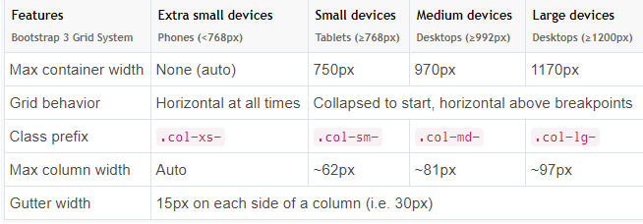
Bootstrap grid

Slide 7
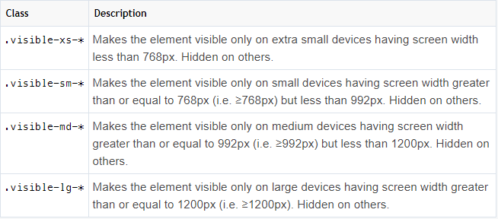
Visibility feature
* Is inline, block and inline-block
Same for Hidden

Slide 8
Functional programming
Purity
No Loops – replace higher-order functions like map and reduce
Avoid Mutation
Persistent Data Structures for efficient Immutability
Structural Change

